Slide 1
DEED 2024 Legislative Policy Proposals
Commissioner Matt Varilek
March 6, 2024

Slide 2
Our Mission
Notes:
DEED: Our Mission
The mission of the Department of Employment and Economic Development (DEED) is to empower the growth of the Minnesota economy, for everyone.

Slide 3
2024 Legislative Policy Proposals

Slide 4
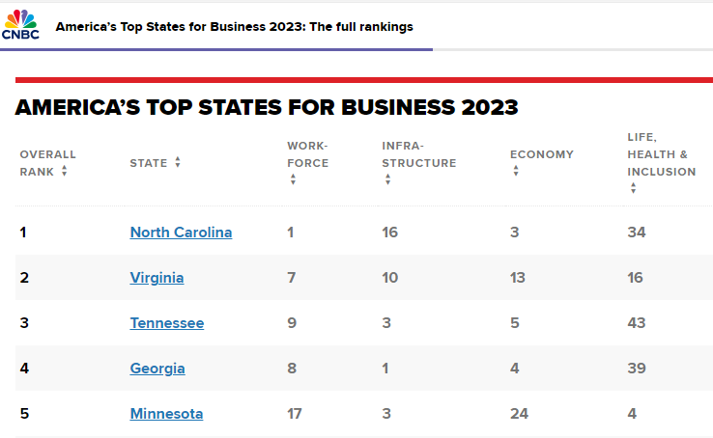
Enhance Flexibility within the Job Creation Fund
Proposed changes to the Job Creation Fund (JCF) (116J.8748) would measure job creation in full-time equivalents to better reflect modern jobs.
Add language to the definition of full-time employee to include:
“has expected work hours of at least 2,080 hours annually or the equivalent of annualized expected hours of work equal to 2,080 hours of one or more employees.”
This change is responsive to employment differences across industries and will create consistency between the JCF and the Minnesota Investment Fund (MIF), a similar business financing program.

Slide 5
Refine the Innovative Business Development Public Infrastructure Grant Program
This proposal makes technical changes to the Innovation Business Development Public Infrastructure Grant Program (116J.435) in response to requests by local units of government that will improve access to qualifying projects. These changes will:
Allow for rolling applications for funds, making the program more responsive
Provide clarification around match requirements
Clearly outline project scoring criteria

Slide 6
Increase Representation on the Energy Transition Advisory Council
The Energy Transition Advisory Council (ETAC) (116J.5492) provides recommendations to the state for communities that will be impacted by fossil fuel-based power plant closures.
The ETAC has representatives from impacted communities, industries and workers but no voices from impacted school districts.
This proposal adds a seat on the ETAC that represents a school district impacted by the energy transition.

Slide 7
Other Jobs Bill Technical Fixes
Add language for the Northland Foundation to receive administrative funding to run the Canadian Border Counties Economic Relief Program.
Adjust the timeline for Launch Minnesota to allow for the use of program funds over a four-year period (for program flexibility).

Slide 8
Improve State Dislocated Worker Program Services
The cost category limitations for the state Dislocated Worker program no longer reflect the needs of dislocated workers.
The current cost categories require significantly more resources to be made available for “career services” rather than “training services” – making it harder for the program to serve more challenged individuals.
Eliminating strict cost categories for this program will allow local areas to tailor their programs to best meet the needs of their participants. This change will also better align the state Dislocated Worker program with the federal, which does not have cost category limitations.
Notes:
There is a common misconception that “career services” do not help advance the career
prospects of participants, and that training services should be prioritized for all participants. However, career
services fund not only one-on-one individualized career counseling, but also for work readiness activities such
as computer literacy, internships, resume writing workshops, job fairs, and other pre-vocational services
essential for individuals to upskill in preparation for re-entry into the labor force. These types of services are
essential to meet the needs of individuals with multiple barriers to employment who need more intensive
one-on-one services to prepare them for the changing labor market, and who also cannot afford the time
away from work to participate in more intensive credentialed training activities, which often require them to
forego a paycheck in order to participate.
Currently grants to providers for the State Dislocated Worker Programs are required to conform to the
following cost categories pursuant to Minn. Stat. 116L.17:
• Administration: No more than 10% of total grant expenditures
• Career Services: No more than 40% of the total grant expenditures
• Direct Customer Training: At least 50% of the total grant expenditures
• Support Services: No more than 15% of the total grant expenditures

Slide 9
Dislocated Worker Program Customer Expansion
In response to the state’s workforce shortage, DEED proposes expanding the eligible populations who can access state dislocated worker services (116L.17).
Adding the following with an intent to increase labor force participation of individuals from underserved populations (and to make the program more responsive to the needs of employers):
A spouse of a member of the United States armed forces who has lost employment due to a service member relocation, is unemployed or underemployed
Individuals with non-work-related injuries or illnesses who need support to re-enter or remain in the workforce
Adults with a low income, are a recipient of public assistance or are basic skills deficient

Slide 10
Thank you!

