Slide 1
THE STATE OF THE Regional ECONOMY
November 2023
Erick Garcia Luna
Director, Regional Outreach

Slide 2
DISCLAIMER
The views expressed here are the presenter's and not necessarily those of the Federal Reserve Bank of Minneapolis or the Federal Reserve System.

Slide 3
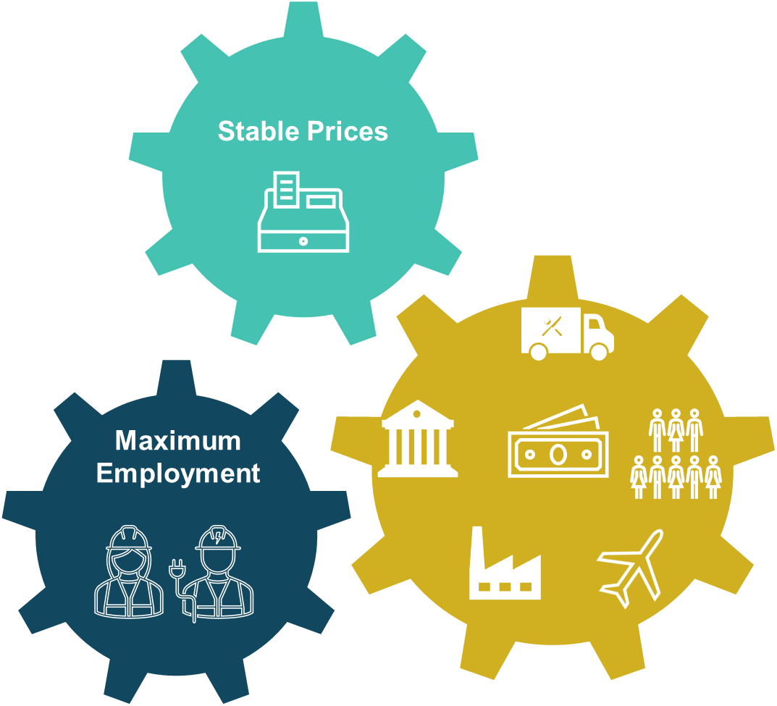
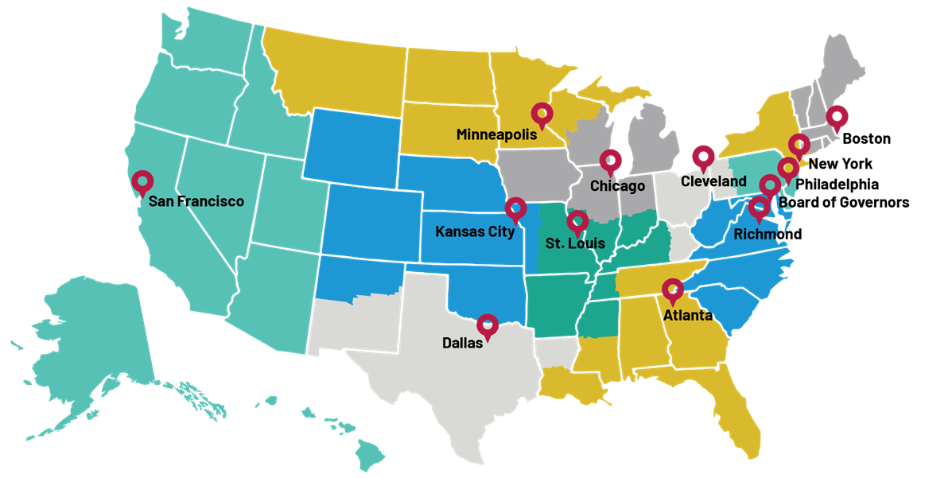
The federal reserve

Slide 4
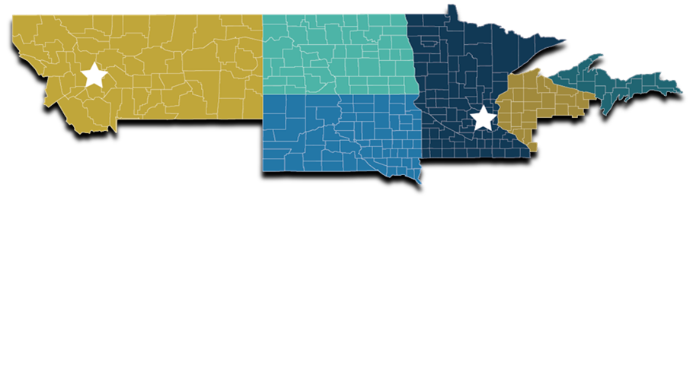
Tracking the economy of the ninth district
Monitor economic activity in the Ninth District.
Analysis of publicly available data
Direct contact with business, labor and community contacts.
Regional surveys
Manufacturing, agriculture, construction, and labor.

Slide 5
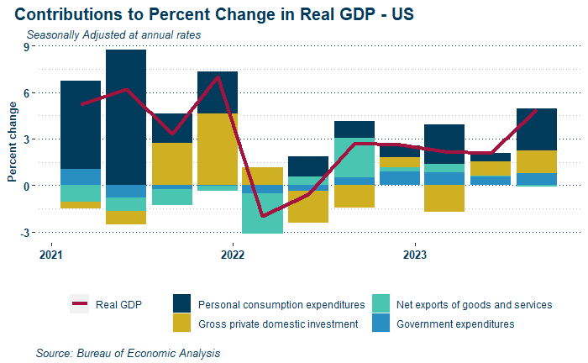
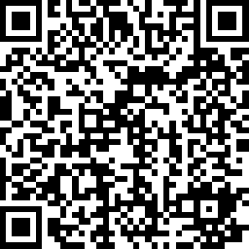

Slide 6
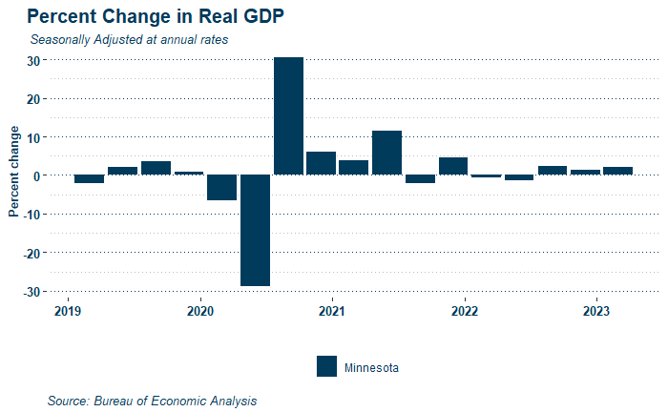

Slide 7
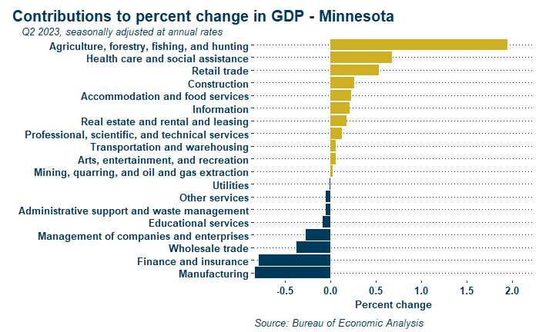
What’s MOVING THE ECONOMY in MN?

Slide 8
The EMPLOYMENT picture

Slide 9
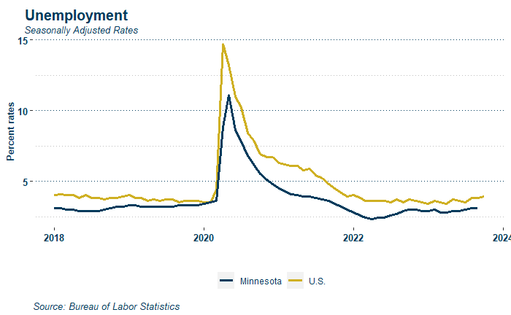
Notes:
The unemployment rate remains low in Minnesota 3.0 vs 3.5 nation-wide

Slide 10
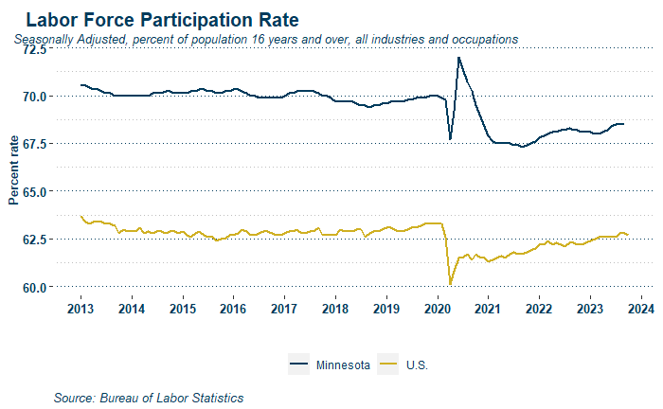

Slide 11
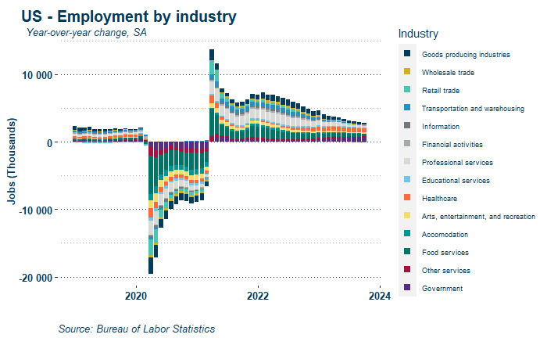

Slide 12
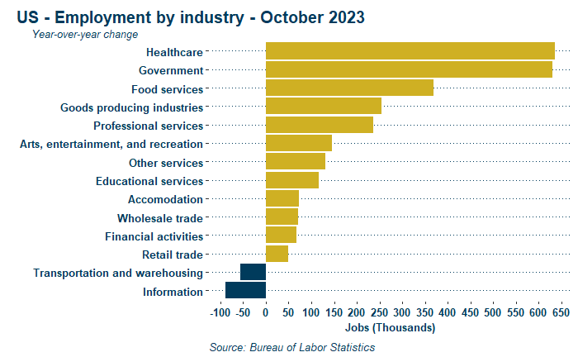

Slide 13
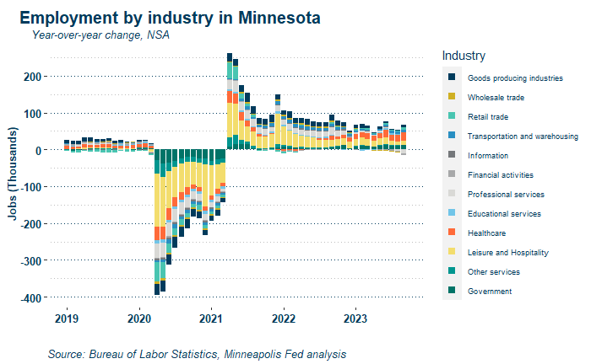

Slide 14
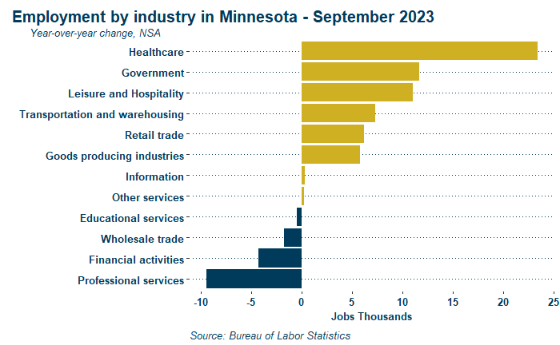

Slide 15
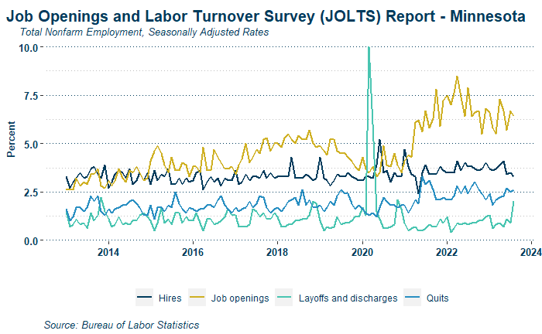

Slide 16
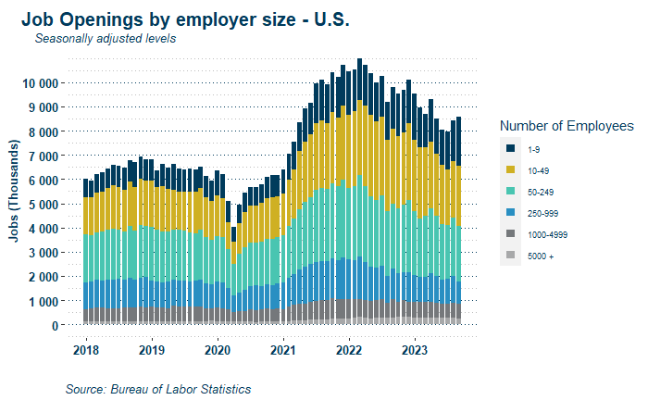

Slide 17
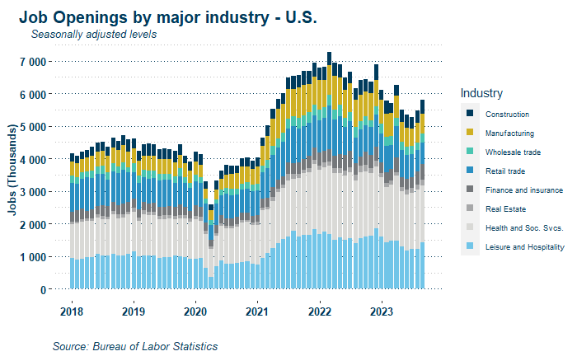

Slide 18
The WORKER EXPERIENCE

Slide 20
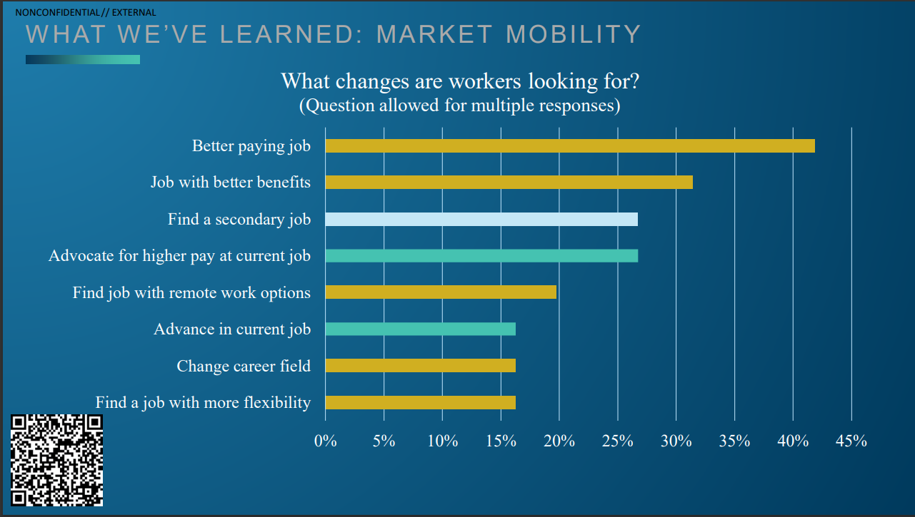

Slide 22
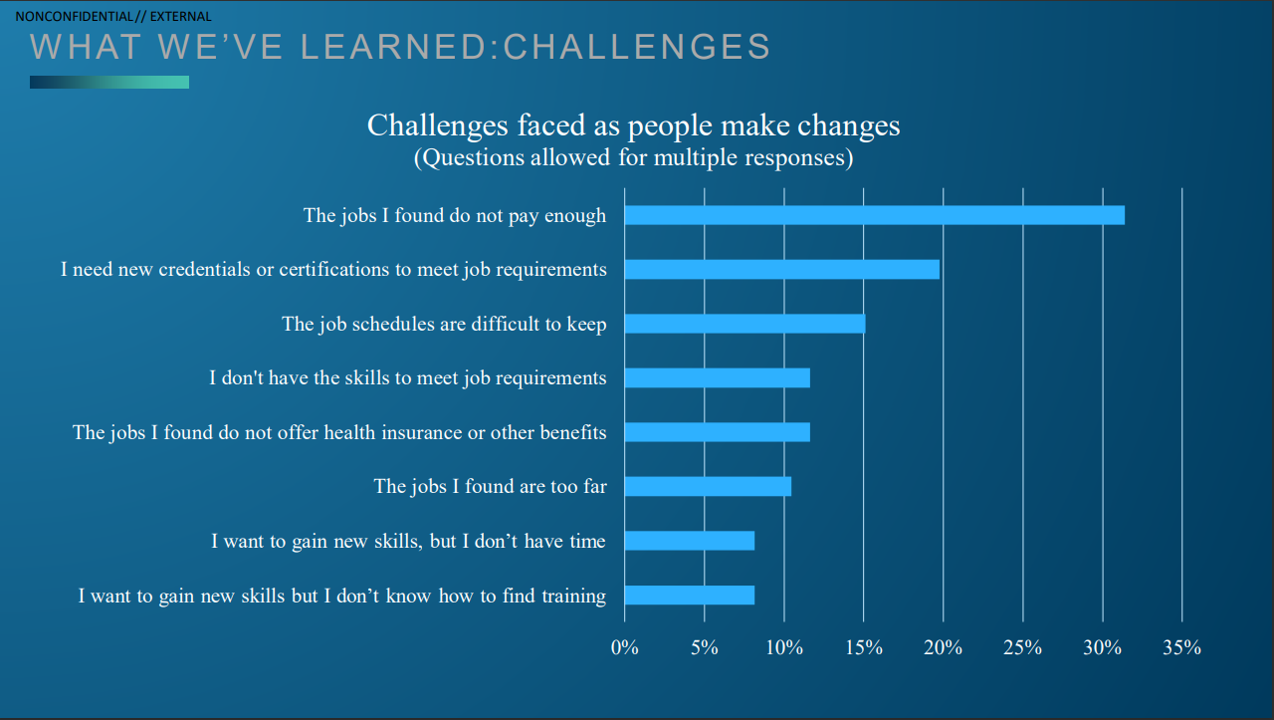

Slide 23
inflation

Slide 24
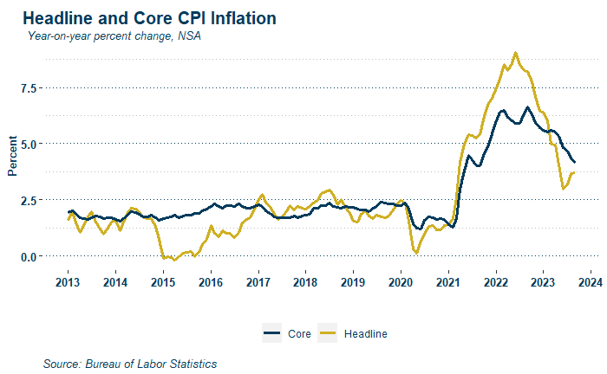

Slide 25
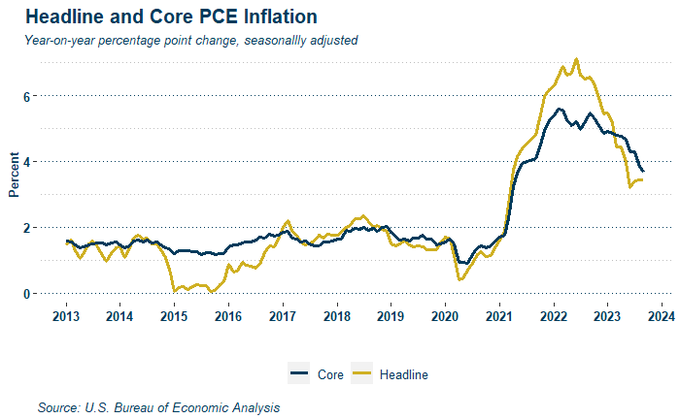

Slide 26
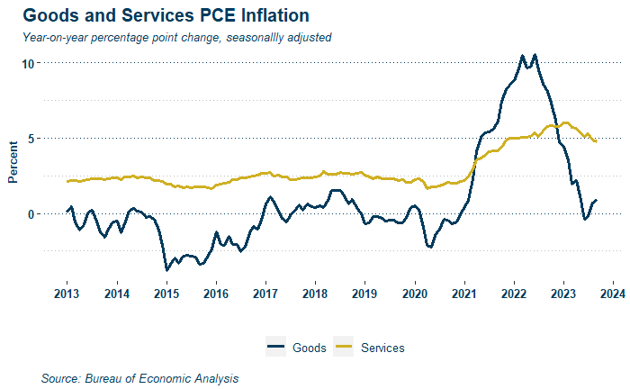

Slide 27
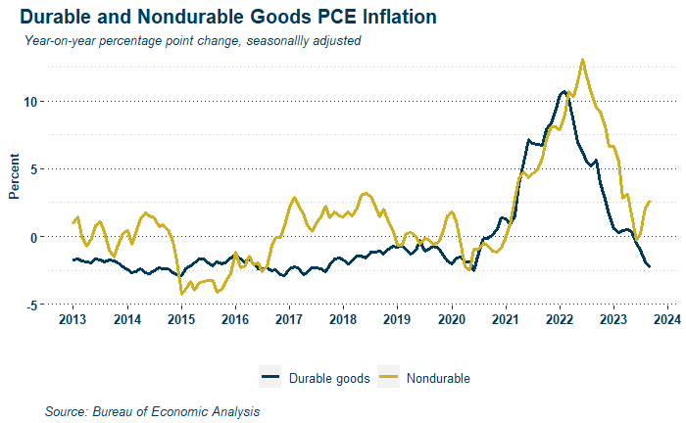

Slide 28
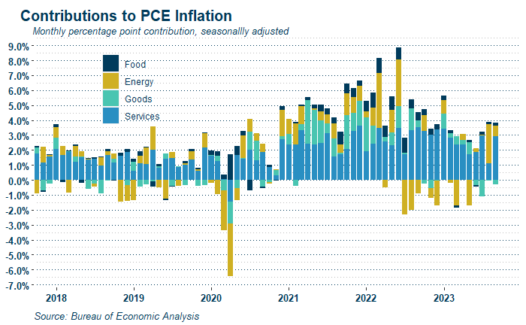

Slide 29
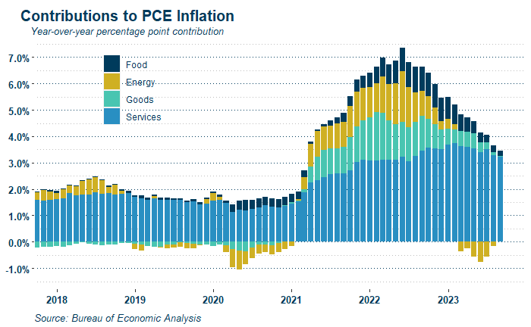

Slide 30
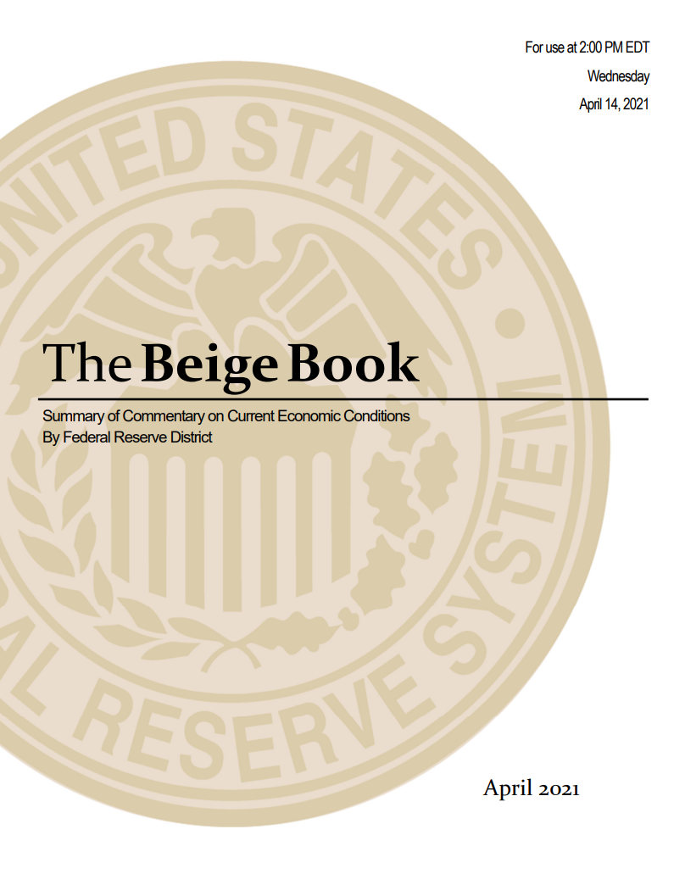
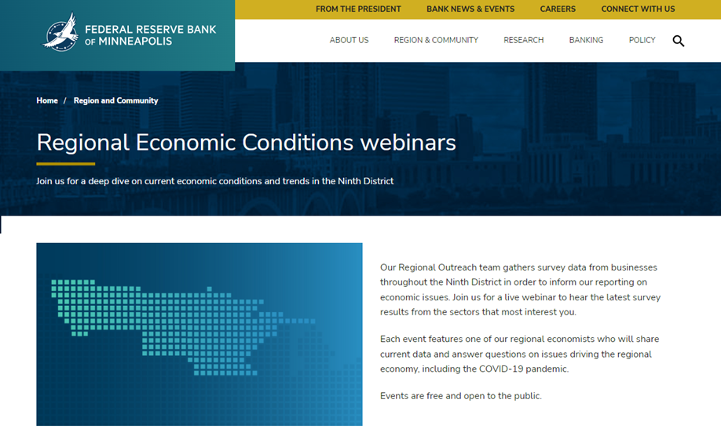
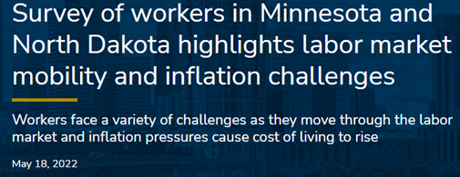
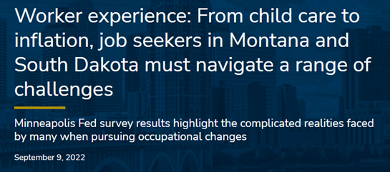
The Beige Book AND OTHER PUBLICATIONS

Slide 31
Thank you!
Erick.Garcia.luna@mpls.frb.org
LinkedIn: Erick Garcia Luna
X(Formerly Twitter):
@erickgarcialuna

